Slide 1
Crack Detection Using Convolutional Neural Network and plotting coordinates of the cracks
VADDE MANJULA MURARi
19CE31001
Under the supervision of
Professor Damodar Maity

Slide 2
Objectives :-
Crack detection is a much-needed task to maintain structural health and ensure the safety of the building.
The main objectives of this proposed project are:
It aims to develop a software tool for the automated detection of cracks on a surface.
Reduce manual work.
Detect cracks on images and highlight the crack portion using image segmentation.
Analyzing video frame by frame, modifying each frame if there is crack and playing the modified frame in sequence as output.
Calculate the length, width and area of crack.
Find the coordinates of the crack so that we can analysis the affect of the crack on the structure in any of the Civil Engineering software.

Slide 3
Literature review :-
S no | JOURNAL | AUTHORS | INFERENCE
1 | Performance Evaluation of Deep CNN-Based Crack Detection and Localization Techniques for Concrete Structures | Luqman Ali, Fady Alnajjar, Hamad Al Jassmi, Munkhjargal Gocho, Wasif Khan, M. Adel Serhani | In this paper compares the performance of Customized CNN, VGG-16, VGG-19, ResNet-50, Inception V3 convolutional neural networks architectures/models for image-based crack detection. This paper says the VGG-19 model benefited from larger datasets. The ResNet-50 and Inception-V3 models demonstrated a slight change in performance after increasing the size of the training data.

Slide 4
S no | Journal name | Author | Interface
2 3 | Deep Learning-Based Crack Damage Detection Using Convolutional Neural Networks. "Concrete Crack Detection Algorithm Based on Deep Residual Neural Networks", Scientific Programming, vol. 2021, Article ID 3137083, 7 pages, 2021. | ha, Y.J.; Choi, W.; Büyüköztürk Xiuying Meng, | In this article there is clear description of the operations that a convolutional neural network performs and show a very simple model that gives high accuracy. There is also mentioned that the accuracy increases with the DB size of the image. In this paper author discussed about an effective architecture which works as encoder and decoder. It also discussed about data labelling image processing technique to highlight the crack and data augmentation is performed to increase the dataset and diverse.

Slide 5
Research gaps and scopes :-
This method can eventually replace human intervention.
If more diverse data is provided then the efficiency can be increased.
Calculation of the depth of the crack using this model requires more complicated architecture as well as the data.
There are many factors for the crack generation and we can relate the characteristics of the crack and the reason of the crack.
Plotting the coordinates require receivers on the ground and a transmitter on the drone but installing a transmitter in a drone and linking it with the model is challenging.
Maintaining drone at a distance of 2m to 3m requires a technical solution.

Slide 6
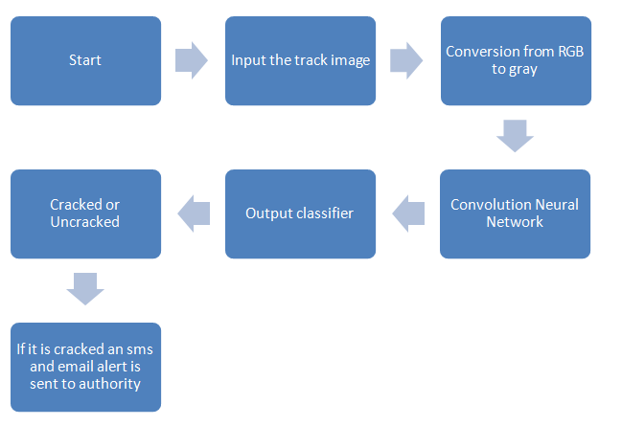
What is CNN?
CNN is a supervised deep learning algorithm, it is used in various fields like speech recognition, image retrieval, and face recognition.
It uses two operations called convolution & pooling to reduce an image to its essential features.
These features help to understand, identify & classify images.
The pre-processing required in CNN is much lower compared to other algorithms.
Basic aim of CNN is to detect patterns(using filters) in the input and
map it with the output.

Slide 7
What is a layer?
A layer consists of small individual units called neurons. A neuron in a neural network is similar to the biological neuron. Here the neuron carries and outputs data to the next neuron. Below is the skeleton of an artificial neuron.
Input are the set of values might be an array, that the model should predict an output using those values. The are similar to the features of the input.
Weights are the real numbers that are attached with the input set and the weights actually convey the importance of the corresponding input value in extracting the feature and patterns from the data.
This weighted summation of the inputs is put into a function called activation function. Activation Function is used to avoid linearity of the predicting model.
Bias is used to shift the activation function towards left or right or up or down so that the model has least loss function/error.

Slide 8
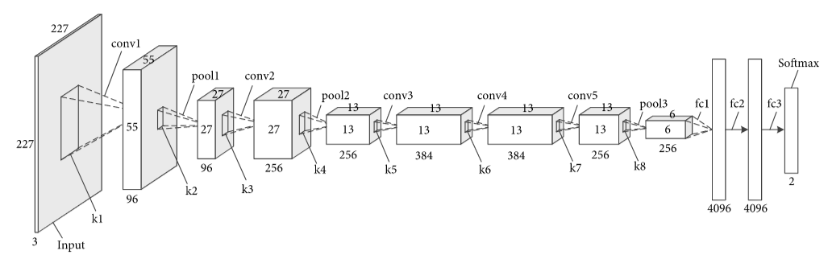
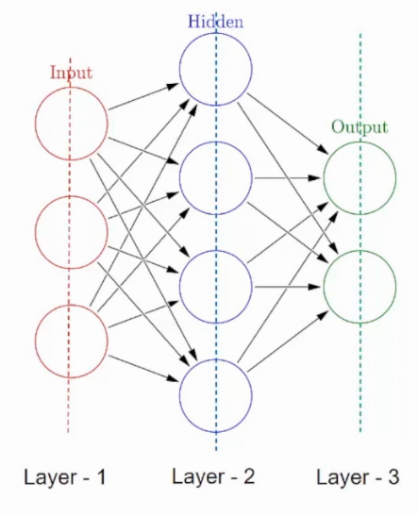
Convolutional Neural network
A layer is a basic calculation unit of a CNN, CNN architecture is formed once the layer is formed.
In the layers of the convolutional neural network, convolution, polling, full connection, and soft max data operations can be performed on the input image along with an activation function.
The kernel behaves like a filter in an image extracting particular information from the original image matrix. A weight combination might be extracting edges, while another a particular color, while another one might just blur the unwanted noise.

Slide 9
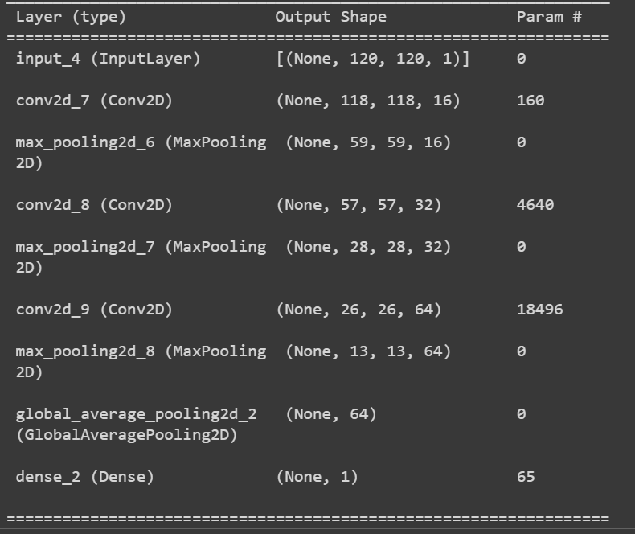
Model
Here is the model we have built for detection of cracks with a convolution layer followed by, max polling followed by, convolution layer followed by, max polling followed by, convolution layer followed by, max polling followed by, global average polling and a dense layer.
We can observe the layers are showing 2D because we have turned every image to GRAYSCALE image to reduce the computational calculation.
The data used is of 20,302 images, were split randomly of 11,369 training images, 2842 validating images, 6091 testing images.

Slide 10
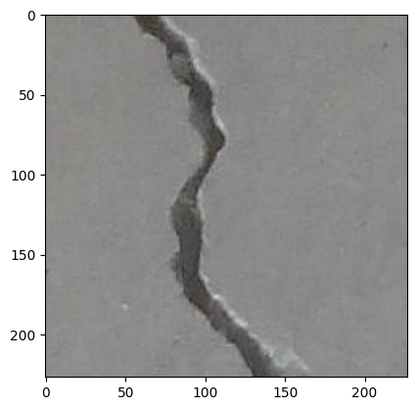
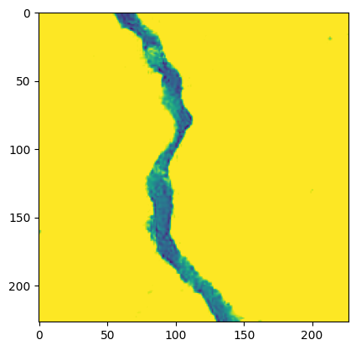
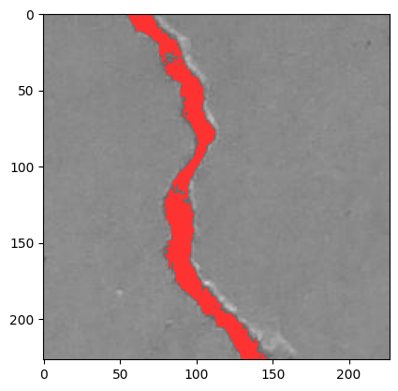
Image Thresholding
Original image
Image thresholding is a technique used in image processing to separate an image into two parts: the foreground and the background.
The foreground refers to the object or region of interest in the image, while the background refers to everything else.
Thresholding works by setting a threshold value, which is a pixel intensity value, and then classifying all pixels in the image as either foreground or background based on whether their intensity value is above or below the threshold value.
All the pixels that are boosted are counted as non cracked region and pixels that are reduced is counted as cracked region. Each pixel is considered to have unit area.
3 channeled BGR image to 2D GRAY_SCALE ⟹ Assign a threshold value ⟹ Boost pixel or reduce pixel ⟹ Boosted pixel converted to GRAY_SCALE pixel ⟹ Image is converted to 3D BGR ⟹ Crack region pixels are assigned red color.
Threshold Image
Modified Image

Slide 11
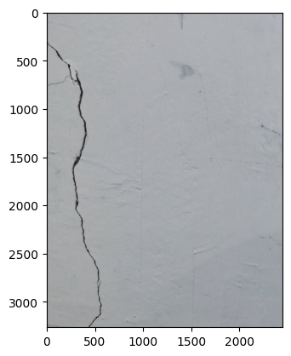
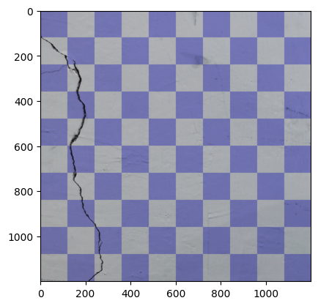
Properties of Crack
The properties of crack, the length of the crack, average width of the crack and area of the crack are derived from an image which has crack. The length of the crack refers to the distance from one end of the crack to the other end.
. The scale of the image depends on type of camera we are using to click the images, the zoom in range we used, also at what distance is the camera is from the surface. The image shown about is the image clicked at 2m distance.
The algorithm implemented to get the length of the crack is:
Segment the image of any resolution equally with (120,120,3) resolution as shown.
Now every segment of the image is fed to the model and asked to predict if there is any crack in the image.
If there is crack in the image then image segment is converted to the GRAY_SCALE and threshold is done.
Contours are made, contours which are very less and very more relative to total area are eliminated.

Slide 12
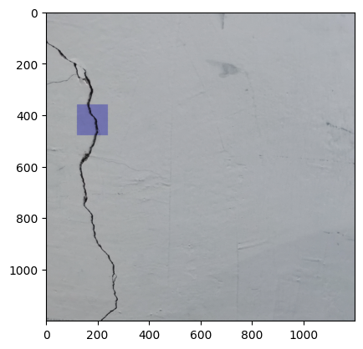
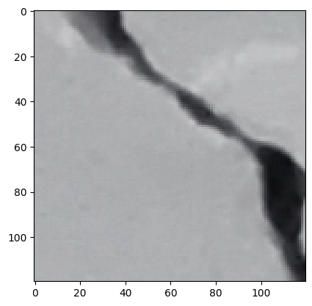
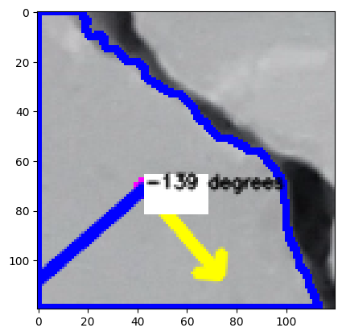
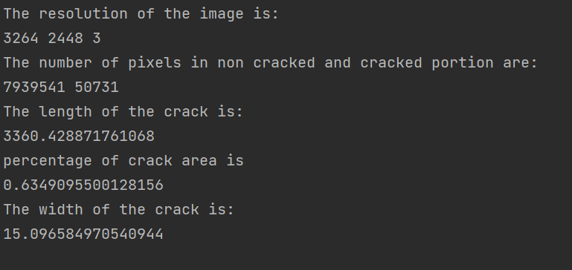
Properties of the crack
Now the orientation of the contours with positive x axis are derived. Crack in the image segment is assumed to pass along one corners of the image and intercept any non-adjacent edges corresponding to that corner.
Project the 120 pixel side on to the elemental length of the crack at the orientation obtained to get the length of elemental crack. Sum all the elemental lengths to get the entire length of the crack.
Initially from thresholding we have calculated the area of the cracked region, that area is evaluated to this pixel size to get the actual area, dividing this new area with length of the crack gives average width of the crack (everything in pixel units).
As the pixel size increases, (120,120,3) becomes relatives smaller, divides the image into much more finer elements, length obtained will be approximately much nearer

Slide 13
Analysis on video using the model
Videos are nothing but a collection of images. These images are called frames and can be combined to get the original video.
Firstly, the size of video is resized according to the model we have built that is, the video is resized to (120, 120, 3) shape.
If the crack is detected in any frame, then we resize that frame to (1200, 1200, 3) now the image is divided into 100 parts of size (120, 120, 3).
Each segment of the image was fed to the model and if the image has crack, then the entire segment is highlighted.
Now all the frames are combined in sequence to get the modified video with the highlighted portion of the crack.

Slide 14
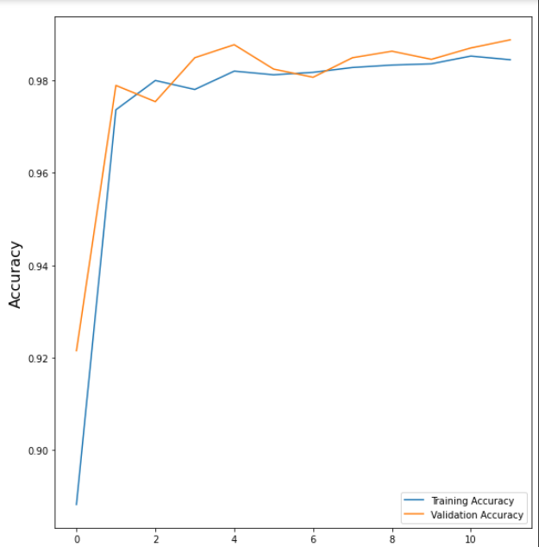
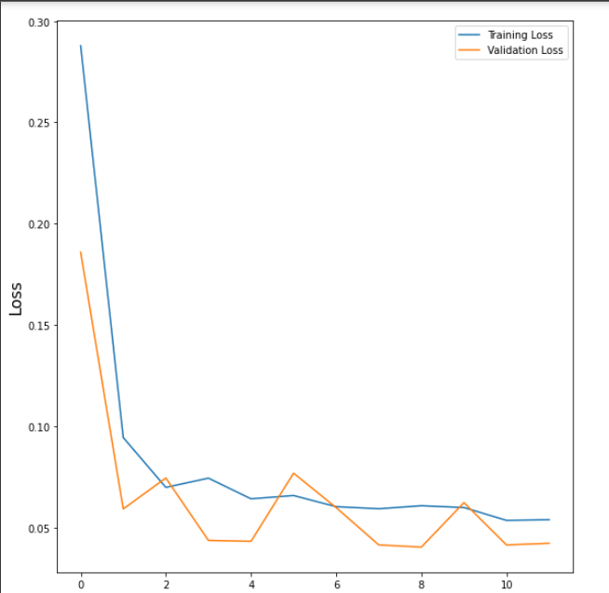
Results
TRAINING RESULTS:
This is training and validations loss vs epoch during the training of the model. As the model learns the weights the model’s loss reduces i.e. the weights for the model should be in such a way that the loss function should have minimum value.
Here is accuracy of training and validation during training of the model vs epoch. We can see that the training accuracy is more than 98 percent
Epoch
Epoch

Slide 15
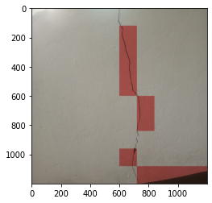
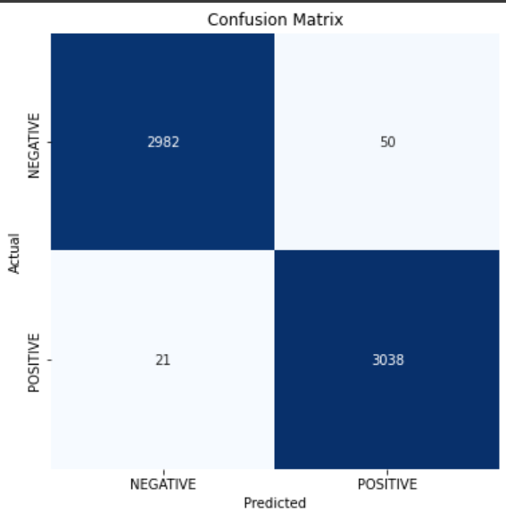
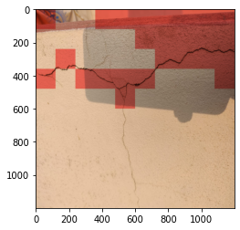
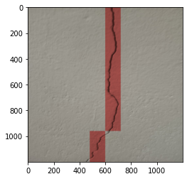
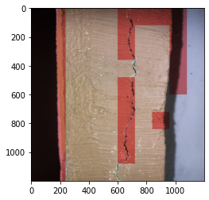
Results
TESTING RESULTS
The figure is the confusion matrix of the testing data, here our model has detected 2982 uncracked images as uncracked, 50 uncracked images as cracked images, 21 cracked images as uncracked and 3038 cracked images as cracked images. We have got a testing accuracy of 98.8%.

Slide 16
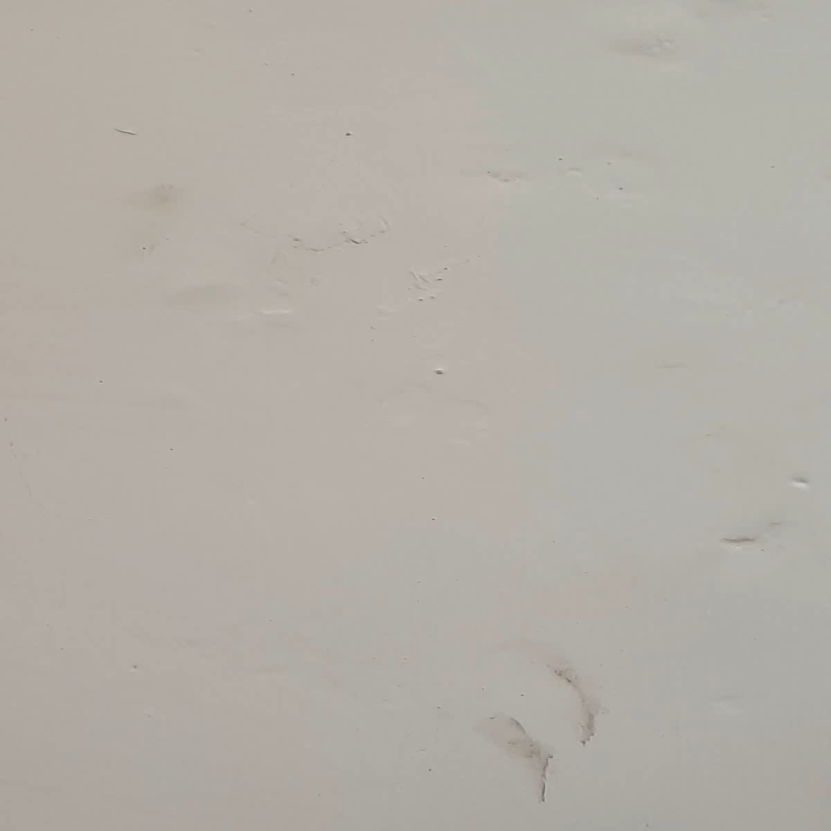
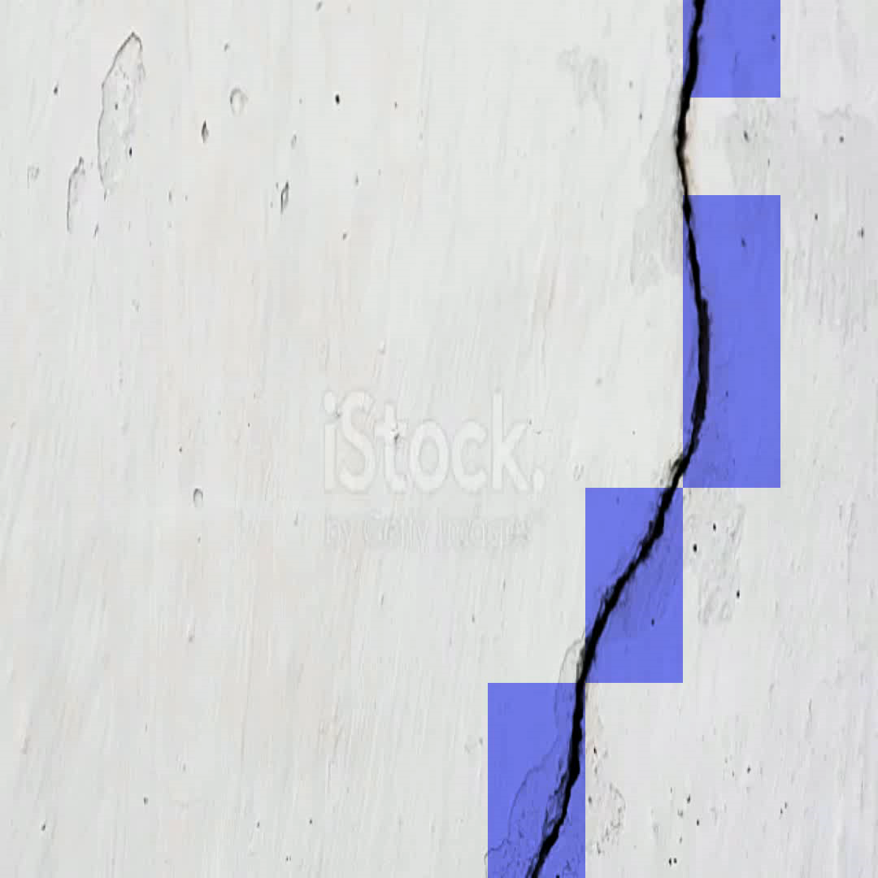
Results

Slide 17
Discussion and Conclusion
We can see that model has high accuracy and the video output with detected portion of the crack is also precise.
In analyzing frames the algorithm we used is on O(n²) time complexity but segmenting frames in binary approach will help in reducing the time complexity to O(n logn).
There is no overfitting of the model from the testing dataset results.
Data augmentation has helped in improving validation accuracy.
Training accuracy is also high which implies the model is able to detect complex data.
Training loss and validation loss are converging towards x-axis, the model isn’t overfitting.
Frame by frame analysis video and adding the modified frames in sequence gave better results and visualization of the frames.
Thresholding an image helps in detecting the exact portion of crack in very less computation as the images are converted to GRAY_SCALE.

Slide 18
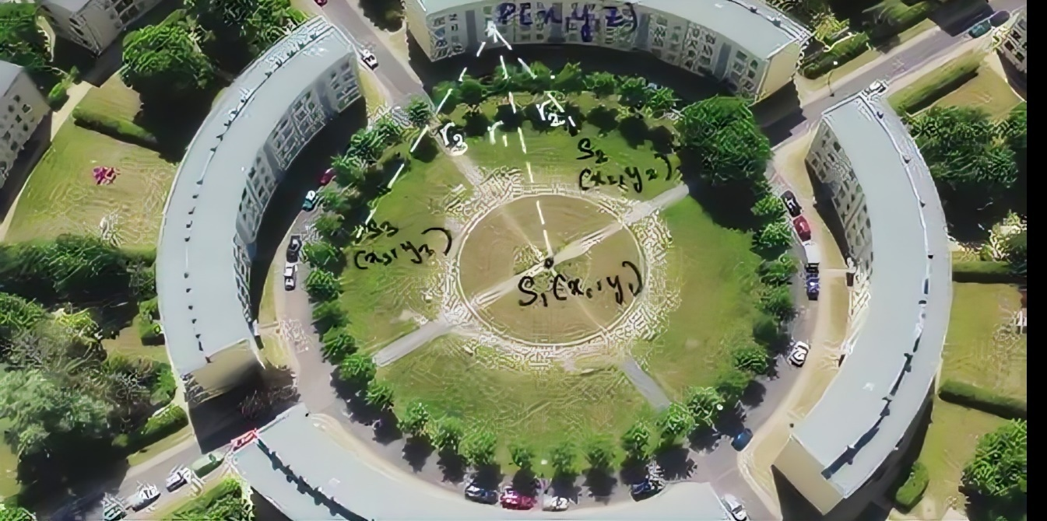
PLOTTING THE COORDINATES OF THE CRACK W.R.T ANY REFERENCE POINT:
The point P(x,y,z) is the point of crack, detected by the drone on the structure.
A signal will be received by the sensors placed on the ground, which is emitted by the transmitter as soon as the signal is detected, and thus the distances of point P i.e r1,r2,r3 w.r.t sensors S1, S2, S3 are returned.
In order to calculate the coordinates of point P:
Equations of spheres with S1 as center and r1 as radius, S2 as center and r2 as radius and S3 as center and r3 as radius are considered.
(x₁-x)²+(y₁-y)²+(z₁-z)² = r₁² ------ equation 1 (x₂-x)²+(y₂-y)²+(z₂-z)² = r₂² ------ equation 2 (x₃-x)²+(y₃-y)²+(z₃-z)² = r₃² ------ equation 3

Slide 19
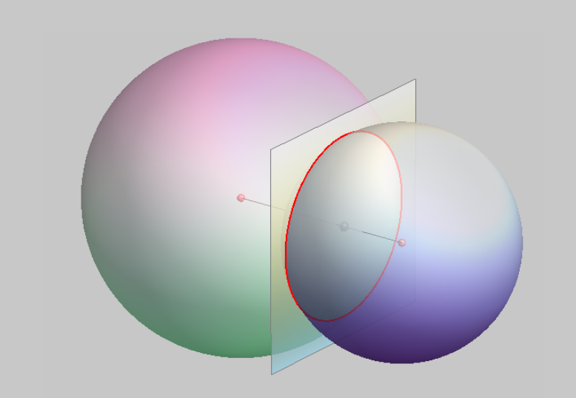
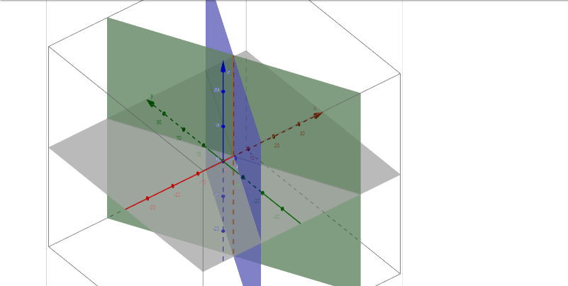
equation 1 – equation 3 : 2x(x₁- x₃) + 2y(y₁- y₃) + 2z(z₁- z₃) = r₃²-( x₃²+ y₃²+ z₃²) – (r₁²-( x₁²+ y₁²+ z₁²)) --------------equation 4 Let, h₁₃= r₃²-( x₃²+ y₃²+ z₃²) – (r₁²-( x₁²+ y₁²+ z₁²)) ; h₁₂= r₂²-( x₂²+ y₂²+ z₂²) – (r₁²-( x₁²+ y₁²+ z₁²))
equation 1 – equation 2 :
2x(x₁- x₂) + 2y(y₁- y₂) + 2z(z₁- z₂) = r₂²-( x₂²+ y₂²+ z₂²) – (r₁²-( x₁²+ y₁²+ z₁²)) --------------equation 5
l₁=2(x₁- x₃) m₁=2(y₁- y₃) n₁=2(z₁- z₃) l₂=2(x₁- x₂) m₂=2(y₁- y₂) n₂=2(z₁- z₂)
We can observe all the sensors on the ground => y1 = y2 = y3 =0 =>m1 = m2 = 0 implies that both planes are parallel to the y-axis. Now solving these two planes gives us the equation of line parallel to y-axis on which point P lies. As the line parallel to the y axis the equation itself gives the coordinates of x and z. For y coordinate solve with any of sensor’s coordinate distance with P.
Coordinates of P are ((h₁₃ n₂ - h₁₂ n₁₎/(l₁n₂ - l₂n₁), y₁ + |√r₁² - (a-x₁)² - (b-z₁)²|, (h₁₃ l₂ - h₁₂ n₁₎/(l₂n₁ -l₁n₂))

Slide 20
Future Work
.
Strong sensors with receivers and a transmitter should be collected of range 300m to 500m with an accuracy of 5cm.
Should find a way to install the transmitters in a drone.
Should find a way to constantly maintain drone at a distance of 2m from the surface.

